Slide 1

Predicting Loan Default in Banks
Mitigating the Risk of Non-Payment
Ajith Menon, Adwaith

Slide 2








Executive Summary
Business Problem
Approach
Contents
Results
Conclusions
References
Recommendations
Appendix
Notes:
For this presentation, 8 sections have been listed to show our whole process and the results of predicted loan defaults.

Slide 3
Executive Summary
Purpose
Predicting Loan Default in Banks
Why?
Default in financial systems indirectly impacts the country’s economy as banks function on a large scale. Moreover, to increase profitability of banks, it is essential to make data driven decisions by identifying potential defaulters.
Numbers
The dataset includes 148,670 rows with 34 columns
Notes:
The objective of this project is to predict loan defaults in banks. This subject was decided upon as loan defaults are related not only to banks' profit but also to the economy of the country. The dataset used in this project consists of 148,670 rows with 34 columns, comprising past data collected by banks of their users.

Slide 4
Business Problem
Problem
How to Solve?
Results
Banks generate a major share of their revenue from lending loans.
Loans are often associated with high risk. One of the setbacks being increase in number of loan defaults.
Collect past data with features of loan borrowers
Utilize forecasting techniques to analyze patterns that are more likely to be present in loan defaulters
Data-driven strategy for analyzing potential and low risk borrowers
Classification models to predict whether the loan borrower will default or not
Comparison of metrics of various classification algorithms and evaluating them based on their accuracy,lift etc.
Notes:
A major revenue is earned by banks through the interest earned by lending loans. However, it is often associated with risk, and loan defaults are one of the major setbacks faced by banks. The risk indirectly impacts the country's economy as well. Therefore, forecasting techniques are being utilized by banks to analyze patterns that are more likely to be present in loan defaulters, to mitigate this kind of issue. It is expected that our classification model, through this project, can make some solutions to reduce the risks in advance, to save bank's profit, and to stabilize the country's economy.

Slide 5

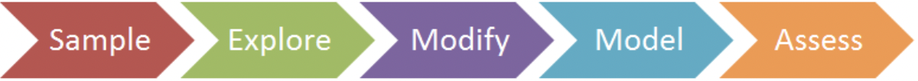
Notes:
The SEMMA process was utilized for Approach to explore and clean the data and to evaluate the best fit model.
In Sample, data can be extracted from the large data set for sampling.
In Explore, outliers and missing values can be checked, and the relationships between predictor variables and target variables can be evaluated.
In Modify, variables can be selected, created, and transformed in preparation for data modeling.
In Model, various modeling (data mining) techniques can be applied to the prepared variables in order to create models that possibly provide the desired outcome.
Lastly, through Assess, the modeling results can be evaluated to show the reliability and usefulness of the created models.

Slide 6


SEMMA - Sample
Data sourced from : Loan Default Dataset | Kaggle
It is comprised of 148,670 records with 34 Columns
The sample data is enormous enough to be applied to the entire domain
Resembles real-life data
Consists of relevant metrics which are related to the loan domain like LTV, DTIR,Income values
Notes:
The loan default dataset was obtained from the Kaggle website. The dataset consists of past data collected by banks of their users. The original dataset is comprised of 148,670 records with 34 columns. Additionally, in these processes, the meaning of each column was confirmed to verify the target variables and the relationships through further steps.

Slide 7

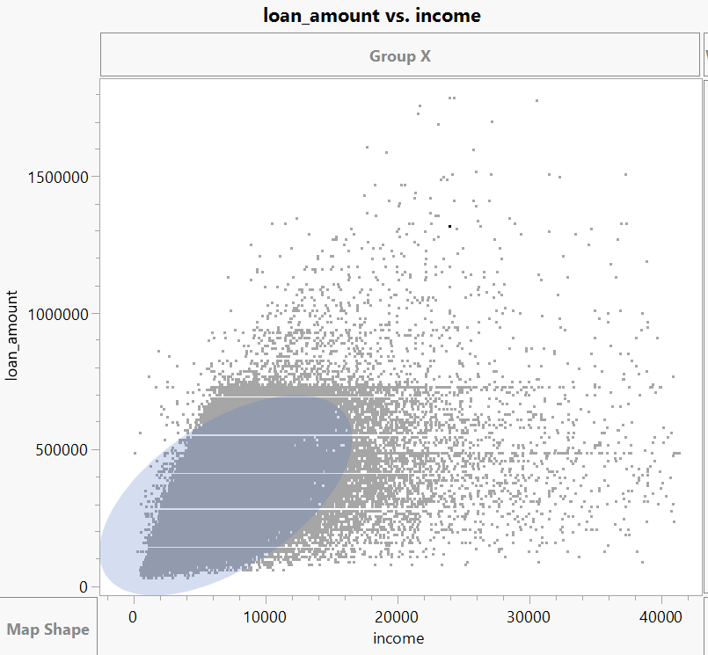
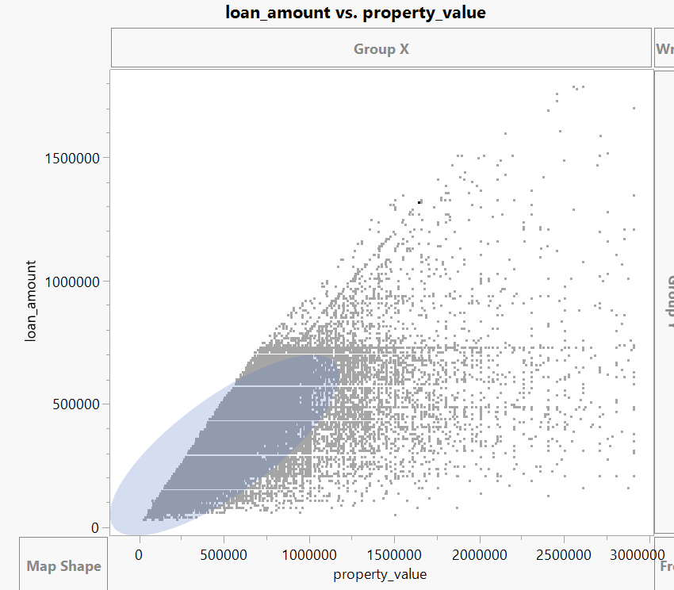
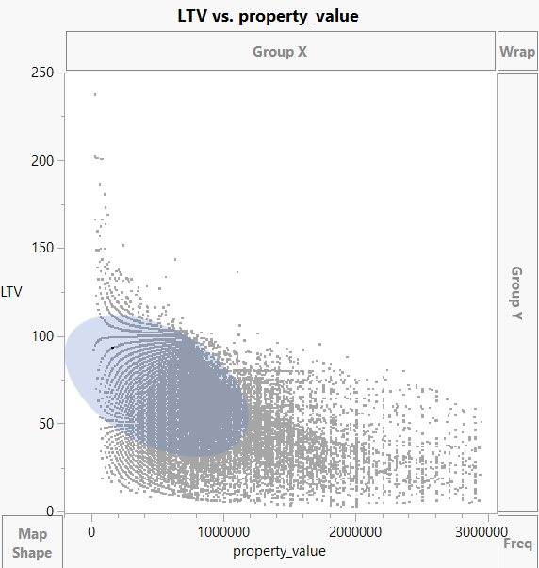
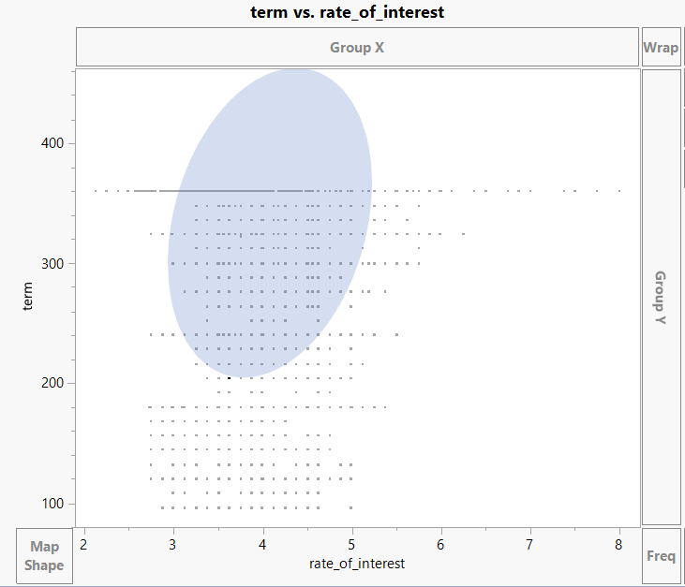
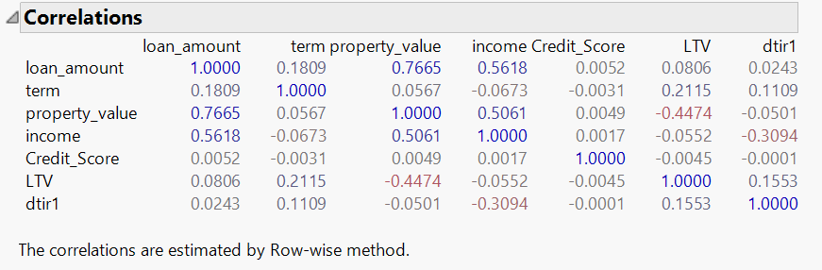
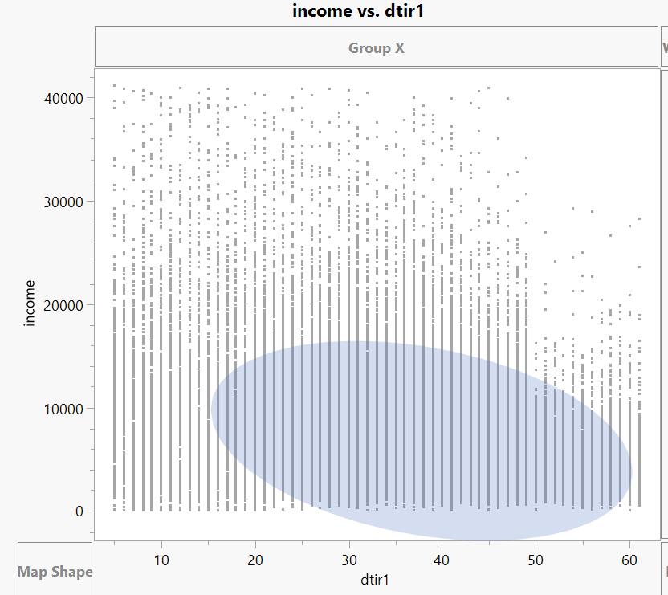
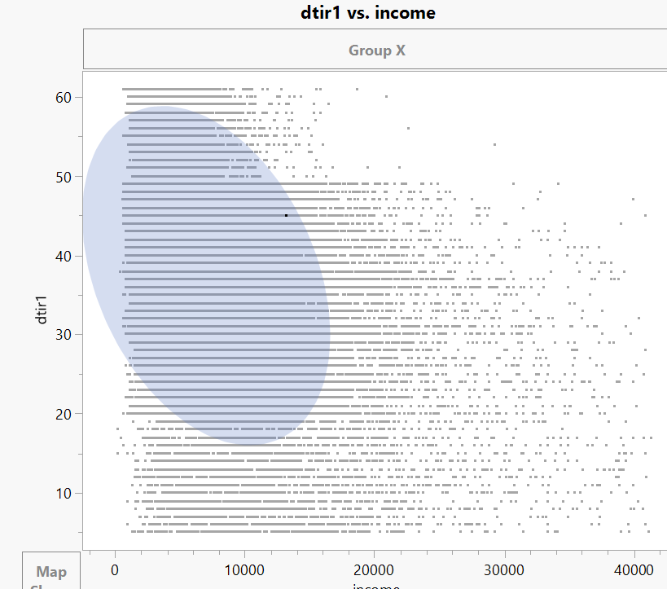
SEMMA - Explore
Defining predictor variables
Determining correlations between variables
Counting missing values & their correspondence with class of interest
Analyzing Relationship between predictor variables and target variable
Outlier analysis
Check the distribution of continuous variables
Notes:
In the Explore process, the correlations between each variable could be checked. Additionally, through exploring the dataset, 28,144 missing values were found. Since imputing values into these rows can impact the integrity of the dataset, it was decided to exclude these values. Furthermore, through the quantile range outliers method with a tail quantile of 0.1 & Q=3, a total of 606 records with outliers in the columns such as loan_amount, Upfront_charges, LTV, and income were found. After excluding these outliers, there were 119,920 records.

Slide 8


SEMMA - Modify
We performed a stratified split on the dataset to train the model with a sufficient number of records with 1s because the number of 1s (class of interest) is only 16.24 percent of the dataset. However, the accuracy of the non-stratified dataset was found to be higher.
Furthermore, because a few of the predictor variables were not normally distributed, we attempted to transform these variables in order to improve the model's performance. However, the model performance for both transformed and original predictor variables was comparable.
Fixing Missing Values: Eliminating missing values and columns which do not contribute to class of interest
Fixing Outliers: Inter-quantile range outlier method to detect and remove outliers
Dimensionality Reduction: Missing values mainly present in columns rate_of_interest, interest_rate_spread and upfront_charges. Moreover, not contributing to class of interest and thus eliminating them from our analysis
Notes:
Modification of data was an essential step in our analysis to make the data less complex and easy to understand. Since the data was enormous, removing the missing values made sense. However, when studying the missing values, it was realized that rows with the class of interest might be lost. Therefore, closely looking at the dataset, the rows were eliminated without getting rid of our default status = 1 rows. The dataset consists of only 16.24% of 1s, i.e., consisting of our class of interest, so it was insisted to keep those rows. Additionally, columns with missing values which did not contribute to our class of interest were eliminated from the dataset. In terms of outlier fixation, potential outliers obtained by the interquartile method were examined in the context of the entire set of data and eliminated.

Slide 9

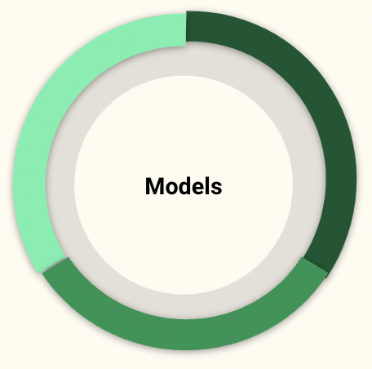
SEMMA - Model
Bootstrap Forest
Logistic Regression
Ensemble Models
Decision Tree
K-Nearest Neighbours
Boosted Tree
Naive Bayes
Neural Network
Notes:
After data cleaning and modifying our dataset, models relevant to our classification problem were run. Logistic regression, decision trees, boosted trees, boosted forest, neural network, naive Bayes, KNNs, and ensemble models were started with. Since the data was imbalanced in terms of the class of interest under Loan_Default_Status column, stratifying data was also considered using Stratified Split balance feature. However, the accuracy remained the same and even decreased in some of the models. Therefore, it was decided to use the actual data during modeling. Moreover, normalizing continuous variables was also tried to get better results, but no improvement in results was observed, and hence it was decided to stick to the actual values.

Slide 10

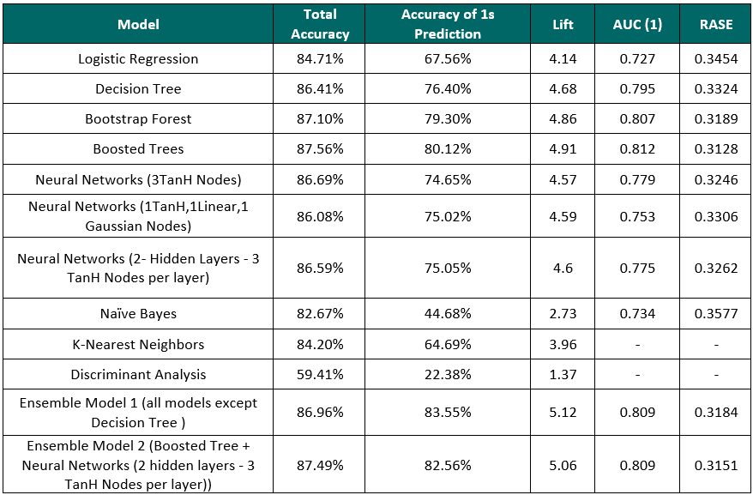
SEMMA - Assessment
Misclassification rate
Confusion Matrix
Accuracy of 1s
AUC
RASE
Baseline Accuracy
Notes:
During the assessment of the models, the Confusion matrix, Fit details, and ROC curve were examined to derive insights into model performance. Key performance metrics such as misclassification rate, total accuracy, accuracy of 1 prediction, Lift, Area Under the curve, and RASE were considered. It was observed that good performance based on total accuracy was achieved in Bootstrap forest, Boosted trees, and Ensemble Model 2. However, since the class of interest was identifying loan defaulters, the accuracy of 1s prediction was considered over Total accuracy.

Slide 11
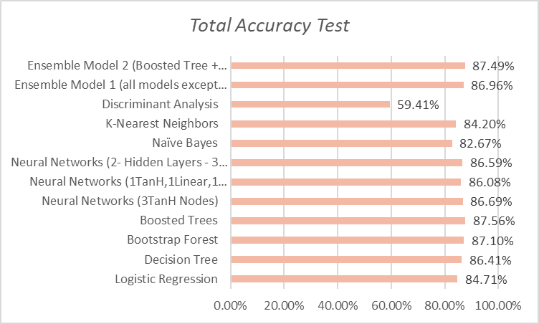
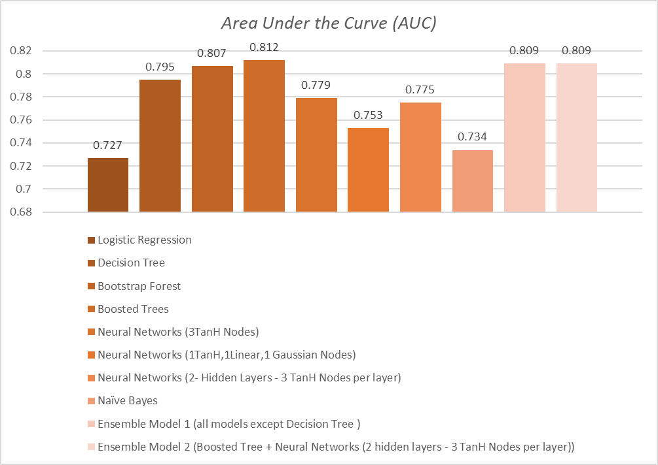
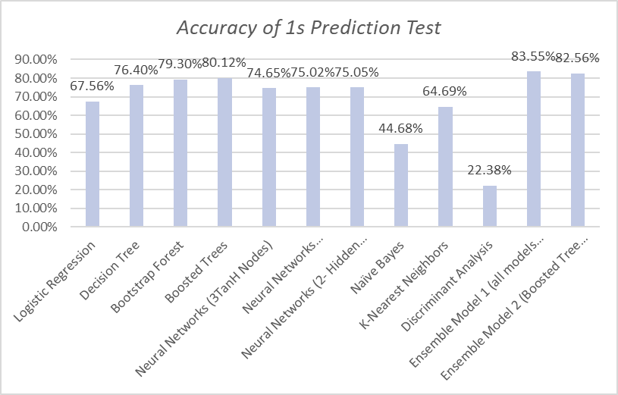
SEMMA - Assessment
Notes:
The major performance indicators considered were AUC, Total accuracy, and Accuracy of 1s prediction. Boosted tree has been found to perform the best in terms of AUC and Total accuracy. On the other hand, Ensemble model 1 has been observed to have better performance in terms of Accuracy of 1 prediction, while still maintaining good performance in other metrics.

Slide 12
Results
Best-Fitting Models
Out of the two models, the Ensemble Model 1 has performed the best in terms of prediction of our class of interest (1s), even though the total accuracy of both the models are comparable.
Boosted Trees
Ensemble Model 1
Total Accuracy : 87.56 %
AUC : 0.812
Accuracy of 1s Prediction : 80.12%
Lift : 4.91
Total Accuracy : 86.496%
AUC : 0.809
Accuracy of 1s Prediction : 83.56%
Lift : 5.12
Boosted Trees model has got a slightly higher total accuracy when compared to Ensemble Model 1
Boosted Trees model has a higher AUC
Ensemble Model 1 has got a slightly lower total accuracy
However , accuracy of 1s prediction is higher for Ensemble Model 1 when compared to Boosted trees model by about 3.5%
Notes:
After the outputs of each model were thoroughly analyzed, the best models were found to be Boosted Trees and Ensemble Model 1. Comparable results were obtained from both models in terms of accuracy, AUC and Lift, but Ensemble Model 1 performed better in terms of accuracy of 1s Prediction, which had been the focus of the modeling from the start. Ensemble Model 1 is not the result of a single model but a combination of models, and its performance is reflected in terms of 1 accuracy, making it robust. Therefore, Ensemble Model 1 was identified as the best model for the analysis.

Slide 13
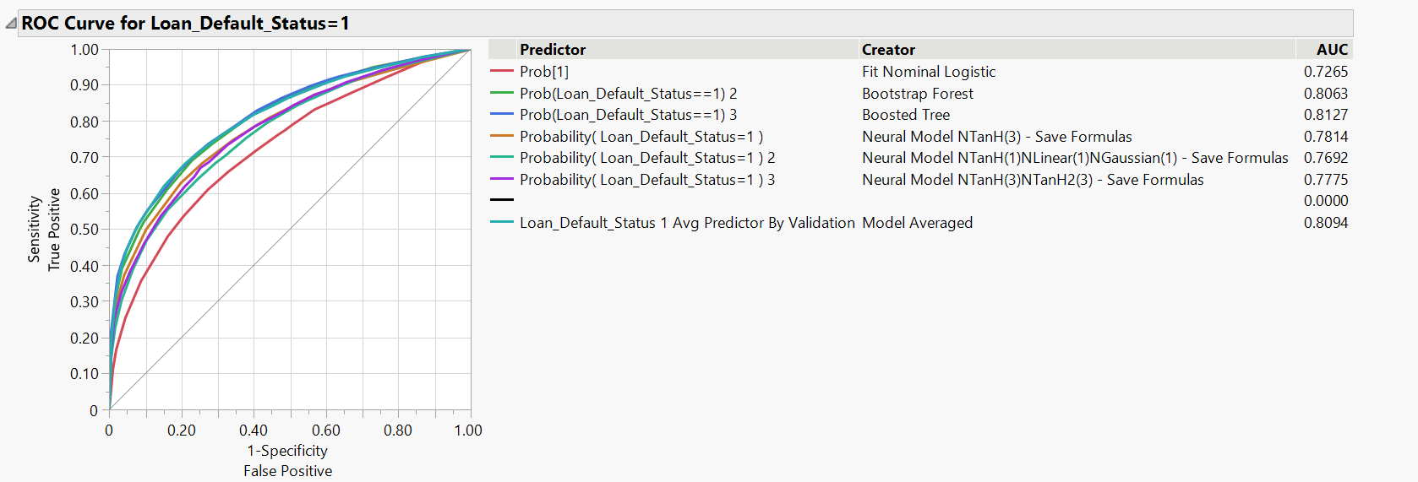
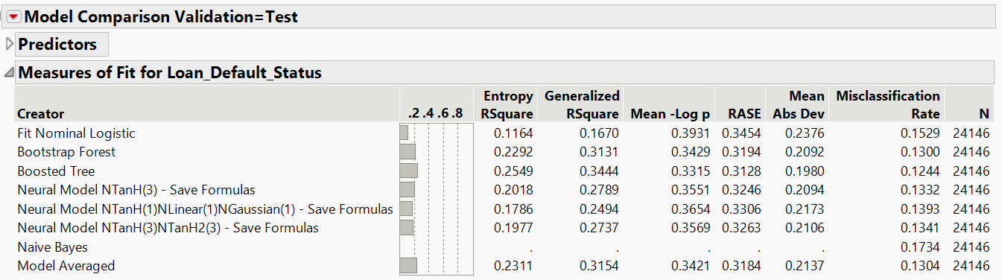
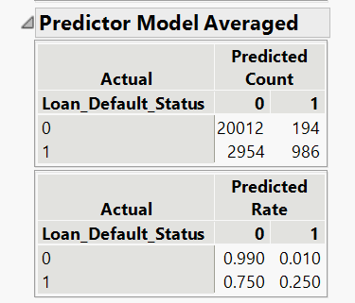
Results
Best Model : Ensemble Model 1
The Ensemble Model was created by averaging Logistic Regression, Boosted Trees, Bootstrap Forests, Neural Networks, and Naive Bayes models
This model outperformed all other contributing models in terms of average predictive performance & reduced prediction errors caused by contributing models
Notes:
Now, our best model and its performance will be examined closely. Overall, our Ensemble Model 1 has performed well under the ROC with an AUC of 0.8094, a misclassification rate of about 13%, and the best accuracy of 1s prediction of 83.55%. The Ensemble model was created by averaging logistic regression, boosted trees, boosted forest, and Naive Bayes Model making it robust in nature. Significantly, as each model used differs from each other, Ensemble reduces the variance in the predictions leading to improved predictive performance.

Slide 14

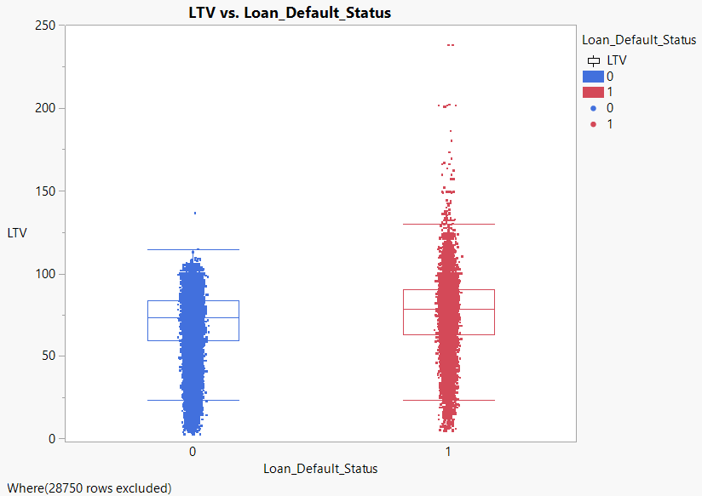
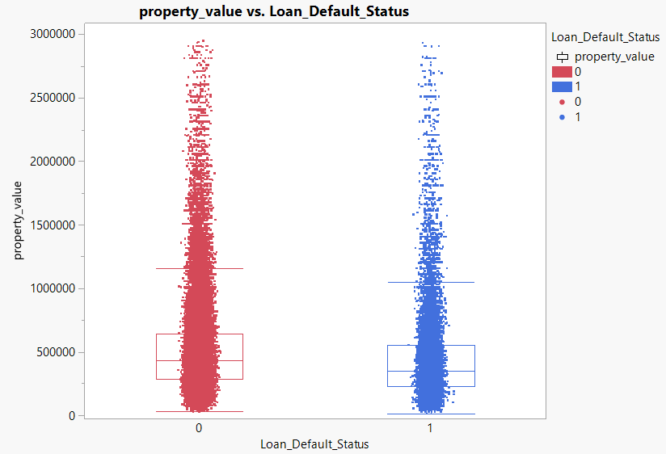
Conclusions
The Loan-to-Value (LTV) ratio expresses the relationship between the loan amount granted to the borrower and the value of the property pledged as collateral
As property value decreases , the LTV ratio increases.
The greater the loan-to-value ratio, the greater the likelihood that the borrower lacks sufficient collateral and, as a result, there is a greater likelihood of loan default
We can see that the median value for LTV is higher for borrowers who have made loan defaults than for borrowers who have not made loan defaults
Notes:
Some important conclusions can be drawn from the overall analysis of various predictive models. The first conclusion relates to the Loan-to-Value (LTV) ratio, which is the relation between the amount of loan granted to the customer and the value of property pledged as collateral. A higher LTV ratio indicates that the borrower is more likely to lack sufficient collateral. As can be observed from the picture, borrowers who made loan defaults had a higher median value for LTV than borrowers who did not make loan defaults.

Slide 15
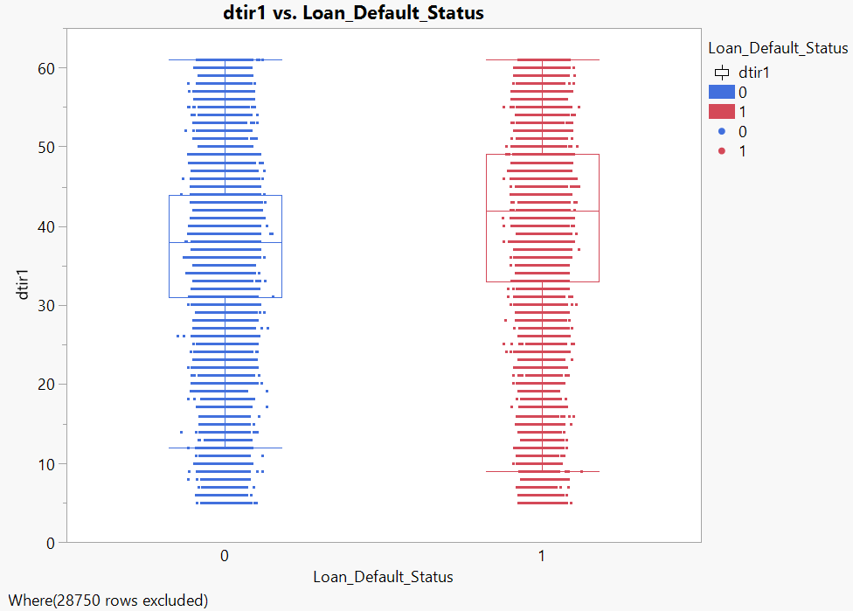
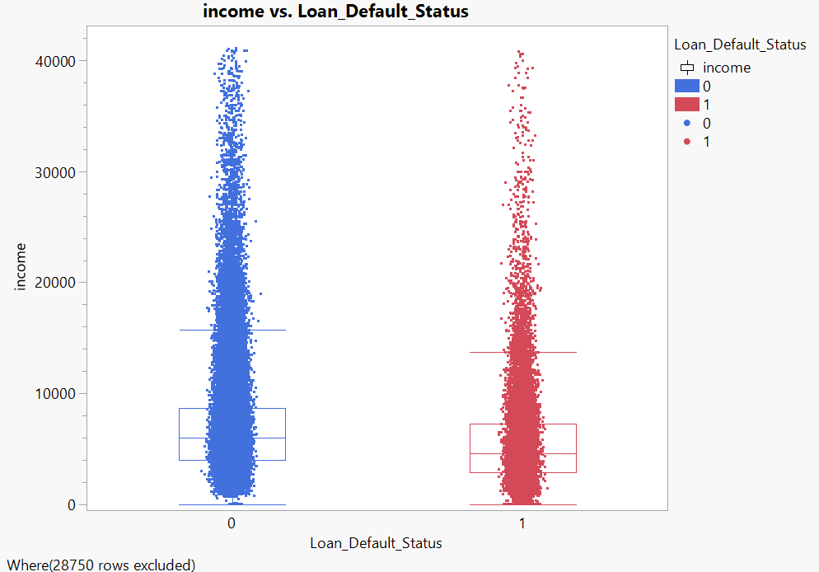
Conclusions
The Debt-to-Income (DTIR) ratio compares a borrower's total debt to his or her monthly income
The higher the debt-to-income ratio, the lower the borrower's income. In the event of unforeseen expenses, borrowers with lower income are more likely to default on a loan in order to meet the essential expenses
Borrowers who have made loan defaults have a higher median DTIR value than borrowers who have not made loan defaults
Notes:
The next factor to consider is the Debt-to-Income ratio, which compares the borrower's monthly debt payments to their monthly income. A higher Debt-to-Income ratio indicates lower income for the borrower, and in unforeseen circumstances, borrowers with lower incomes are more likely to default on the loan. As shown in the picture, borrowers with a higher median DTIR have defaulted on their loans.

Slide 16
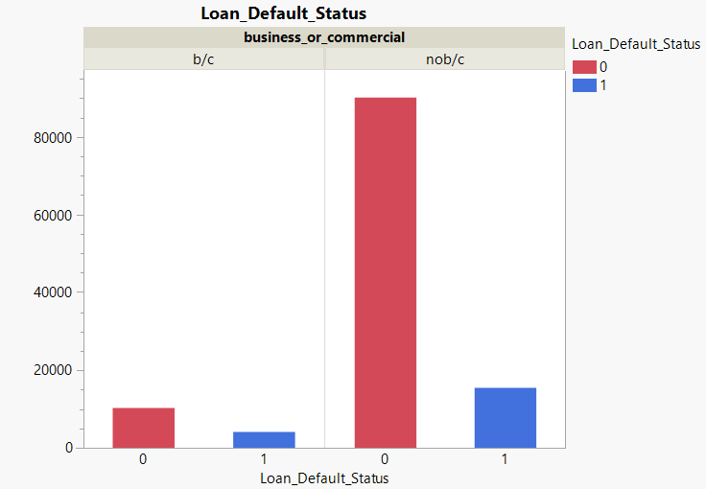
Conclusions
The loans have been divided into two categories: commercial/business and non-commercial
The number of defaults to the number of no-defaults ratio for non-commercial loans is 0.171
The number of defaults to no-defaults ratio for commercial & business loans is 0.396
As a result, when compared to non-commercial loans, there is a higher percentage of business/commercial loans that are defaulted on
Notes:
The loans have been classified into two types, namely commercial/business loans and non-commercial loans. It is observed that the ratio of defaults to non-defaults for commercial/business loans is 0.396, whereas for non-commercial loans it is 0.171. This indicates that a higher percentage of business loans are defaulted on when compared to non-commercial loans.

Slide 17
Recommendations
For Existing Customers:
Banks may ask borrowers to restructure their loan repayment model in order to reduce defaults while extending the loan term
This could be advantageous to the bank in two ways:
1. There are fewer loan defaults
2. Increased revenue (in the form of higher interest paid by the borrower) due to the term being extended (both leading to higher overall profitability)
For New Loan Applications:
Banks could lower the LTV ratio threshold above which loan applications would not be processed. If the LTV ratio exceeds the threshold, there is a greater risk of loan default, which can have an impact on the bank's profitability
Aside from the DTIR ratio, which evaluates the individual's income, banks must ensure that all of the borrower's debts have been included in the credit history. If certain debts are not included in the credit history but are still owed, the DTIR ratio will remain low despite a higher risk of loan default. Hence, a comprehensive profile evaluation should be part of the approval process.
The borrower's age should be considered when approving the loan. If the borrower is over the age of 50, for example, the loan term should be set so that the borrower can repay the loan before retiring. Lump-sum repayments could be incorporated into the loan structure.Furthermore, the maximum borrowing limit set for such borrowers should be lower than that of a typical borrower.
Notes:
Here are a few recommendations based on the results and conclusions, for both existing and new loan applications by the banks:
For existing customers :
Borrowers could be asked by banks to restructure their loan repayment model in order to reduce defaults while extending the loan term. This could result in fewer loan defaults and increased revenue for the bank in the form of higher interest paid by the borrower due to the term being extended, leading to higher overall profitability for the banks.
For new loan applications :
The LTV ratio threshold above which loan applications would not be processed could be lowered by banks. If the LTV ratio exceeds the threshold, there is a greater risk of loan default, which can have an impact on the bank's profitability.
Banks must ensure that all of the borrower's debts have been included in the credit history, in addition to the DTIR ratio which evaluates the individual's income. If certain debts are not included in the credit history but are still owed, the DTIR ratio will remain low despite a higher risk of loan default. Hence, a comprehensive profile evaluation should be part of the approval process.
When approving the loan, the borrower's age should be considered. If the borrower is over the age of 50, for example, the loan term should be set so that the borrower can repay the loan before retiring. Lump-sum repayments could be incorporated into the loan structure. Furthermore, the maximum borrowing limit set for such borrowers should be lower than that of a typical borrower.

Slide 18
References
Heuristic Exploration of Loan Default:
http://ijream.org/papers/IJREAMV06I1171006.pdf

Slide 19
THANK YOU

Slide 20
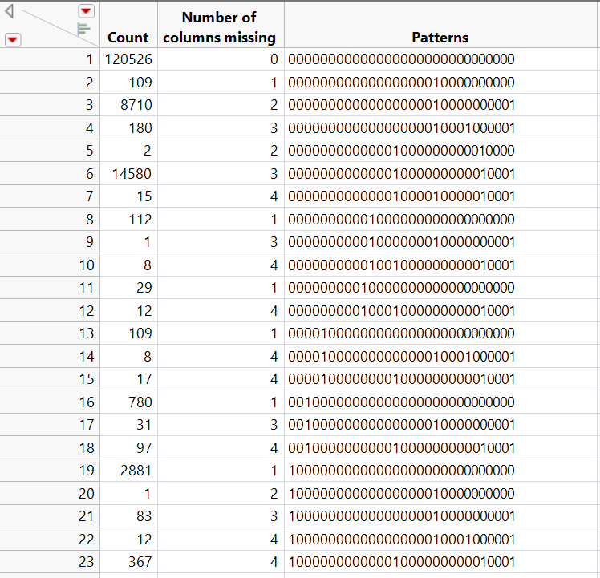
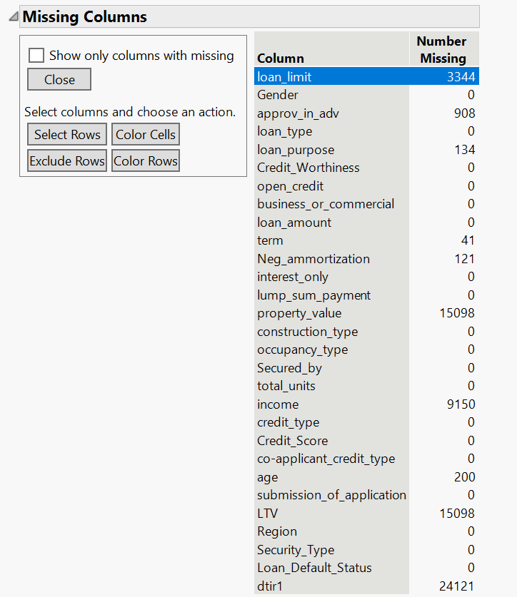
Appendix
Exploring the dataset, total number of records with missing values are found to be 28,144
Imputing values into these rows can impact the integrity of the dataset and hence our analysis, therefore we have opted for exclusion
Missing values

Slide 21
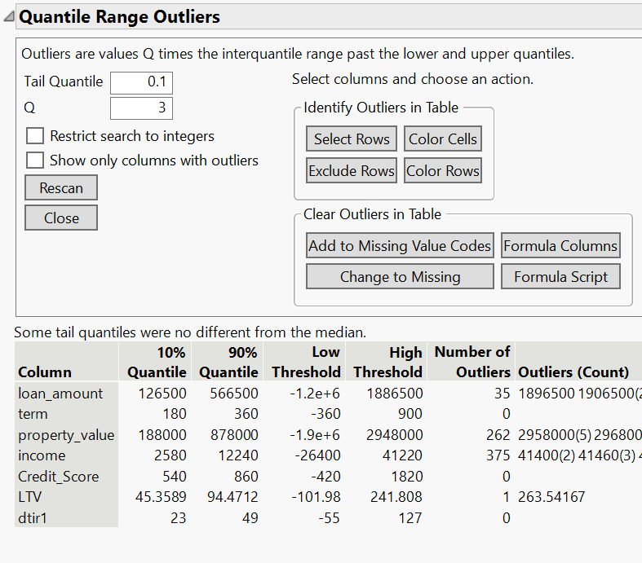
7. Appendix
Outliers
Using the quantile range outliers method with a tail quantile of 0.1 & Q=3, we found that we have a total of 606 records with outliers in the columns : loan_amount , Upfront_charges , LTV and income
After excluding the records with outliers , we have 119,920 records for our further analysis

Slide 22
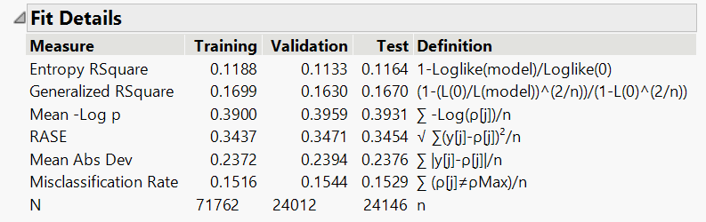
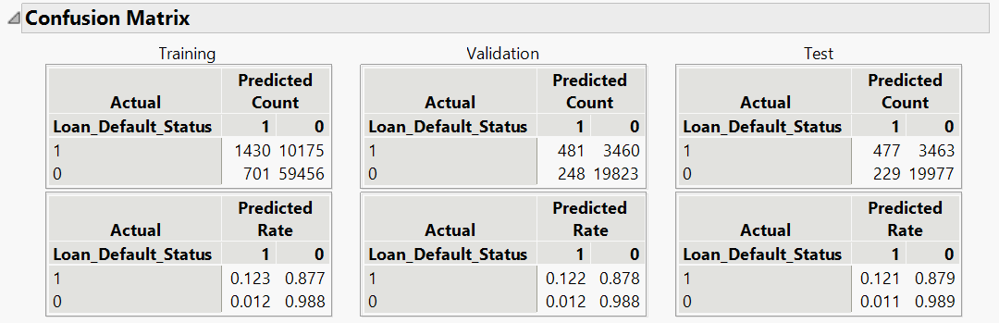
Appendix
Model - Logistic Regression
Nominal Logistic Regression
Variables Excluded : The following variables have been
excluded since the p-value is greater than 0.05 :
* dtir_1
* open_credit
* Credit_Score
* loan_amount
* construction_type
* credit_type

Slide 23
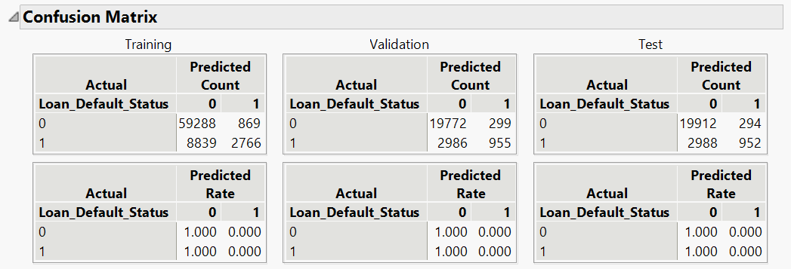
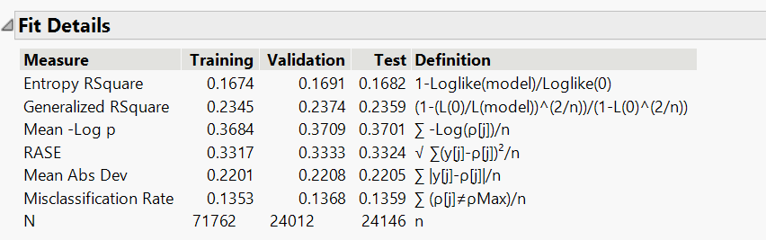
7. Appendix
B. Decision Tree
Number of splits: 20
We have considered 20 splits to be optimum since the
misclassification rate was found to be the least when the number
of splits was 20(considering the complexity of the model)

Slide 24
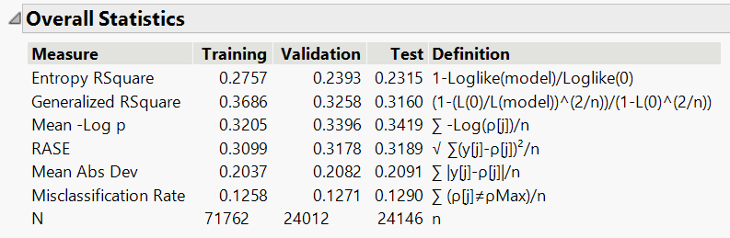
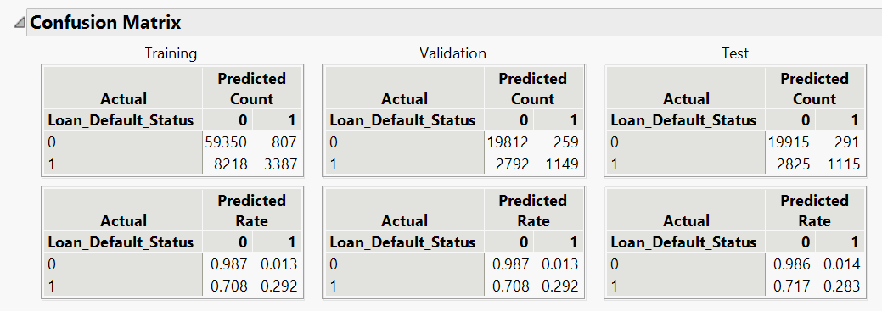
7. Appendix
C. Bootstrap Forest:

Slide 25
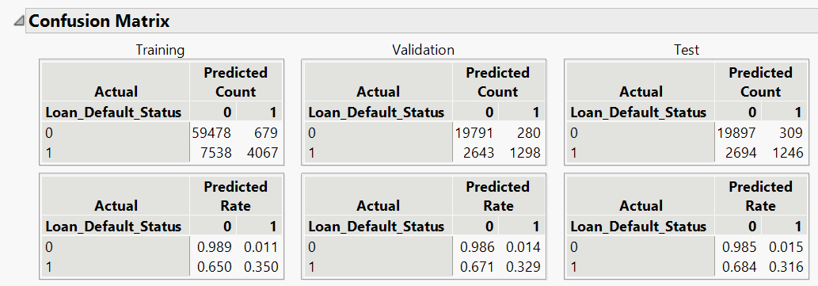
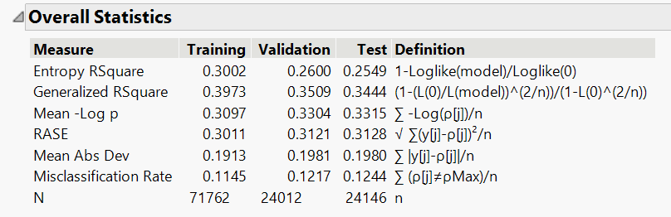
7. Appendix
D. Boosted Tree

Slide 26
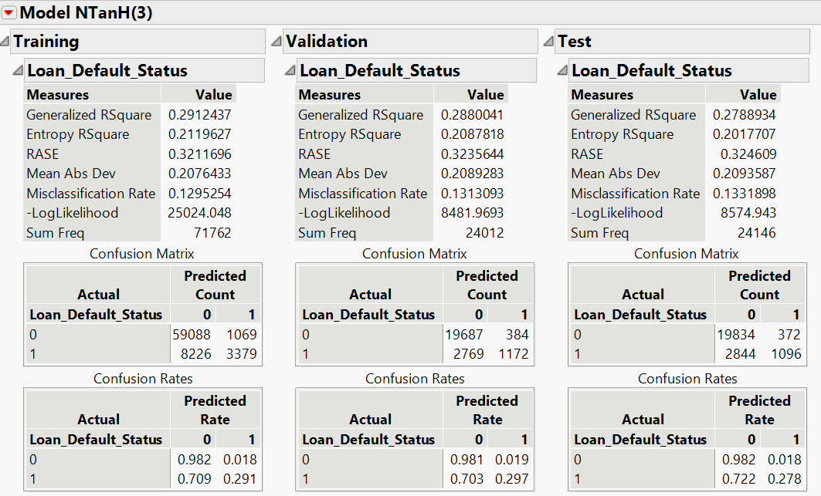
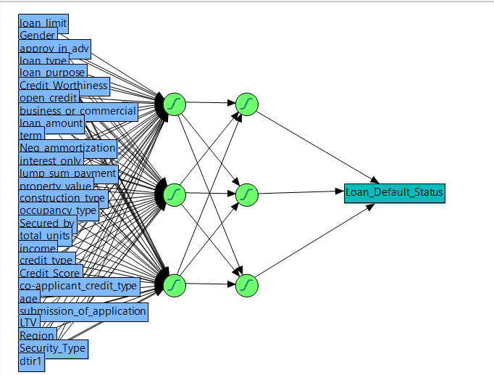
7. Appendix
E. Neural Networks (NTanH(3)

Slide 27
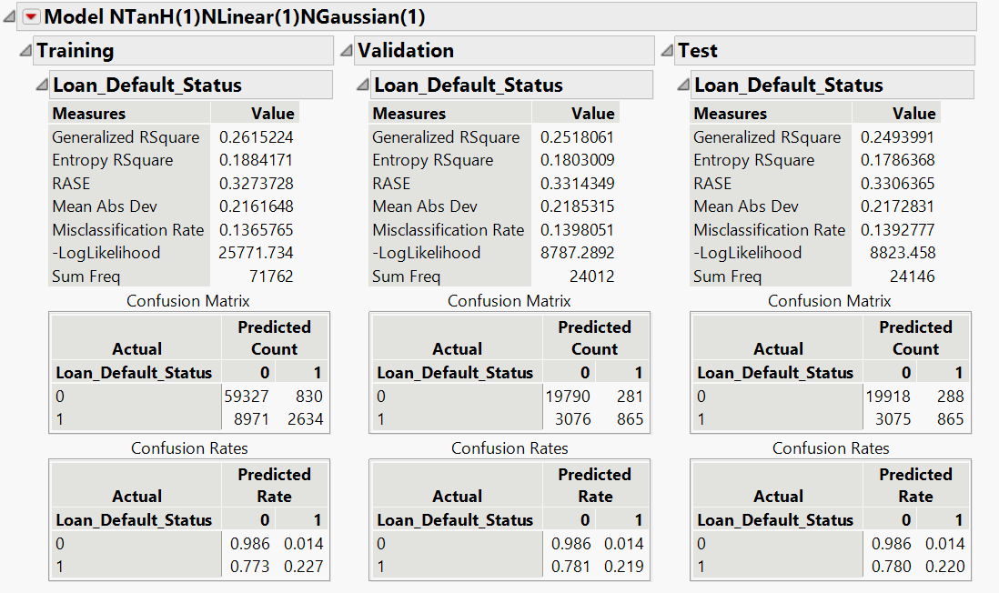
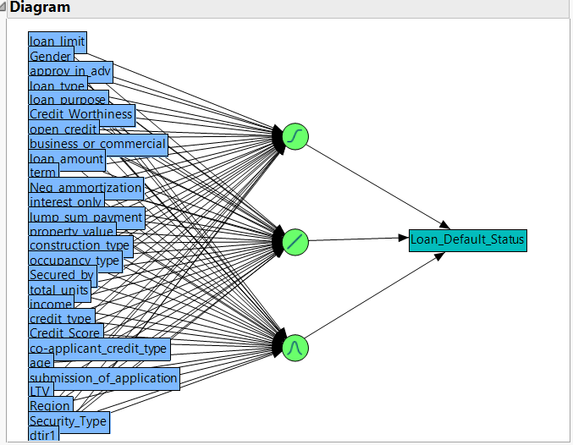
7. Appendix
F. Neural Networks (NTanH(1)NLinear(1)NGaussian(1))

Slide 28
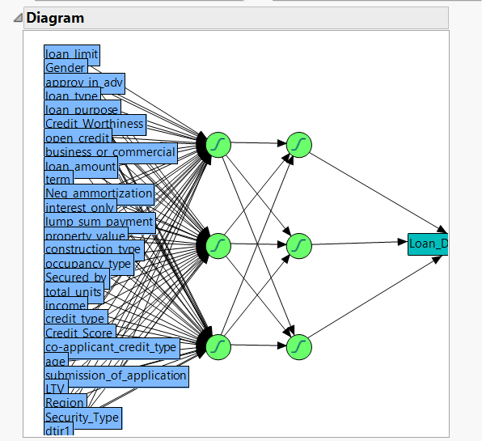
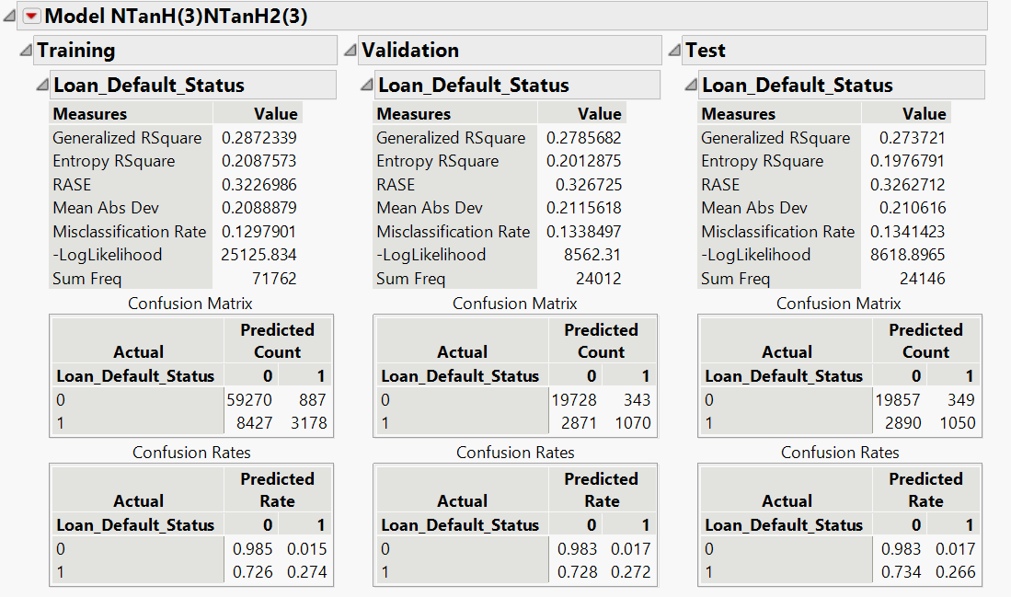
7. Appendix
G. Neural Networks (NTanH(3) NTanH2(3))

Slide 29
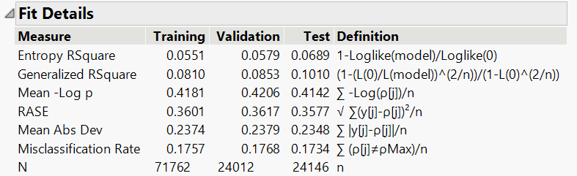
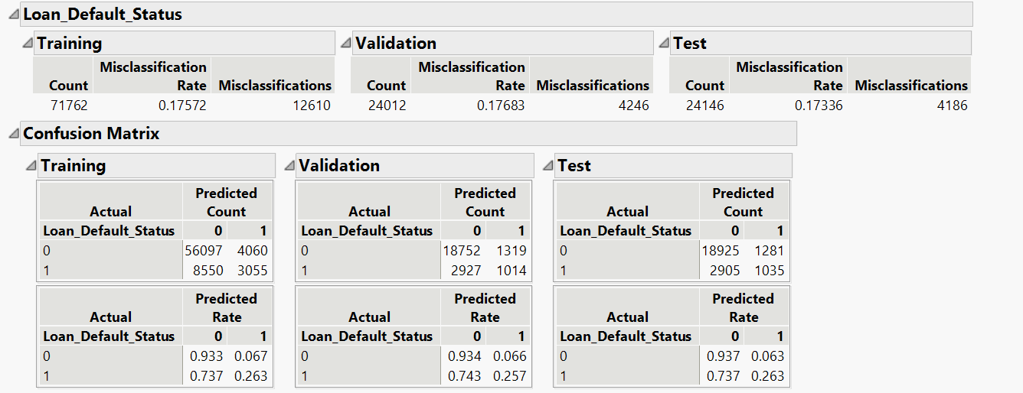
7. Appendix
H. Naive Bayes

Slide 30
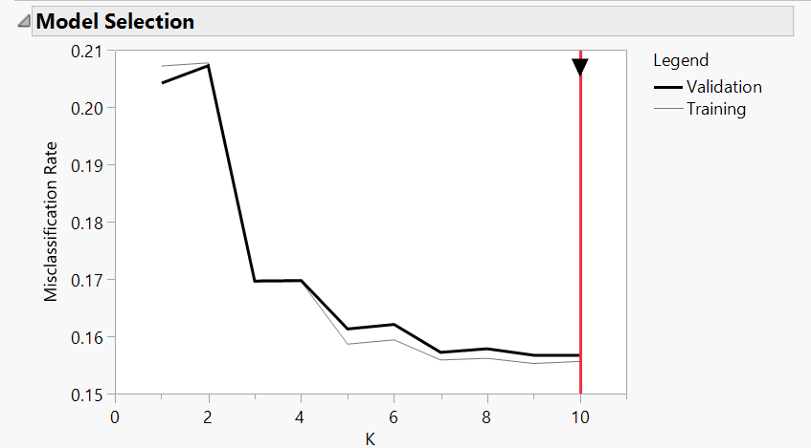
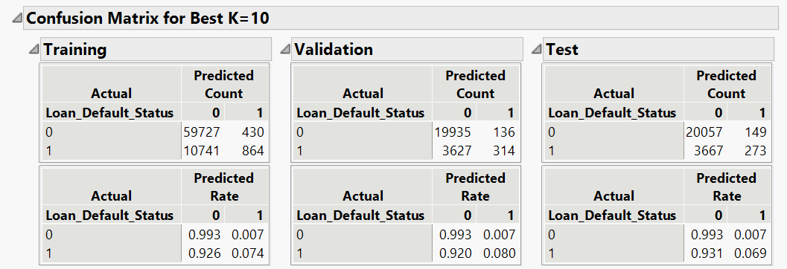
7. Appendix
I. K-Nearest Neighbours
Optimum value for K = 10 (based on the validation set)
When K= 10 , we have the lowest misclassification rate
for the validation set

Slide 31
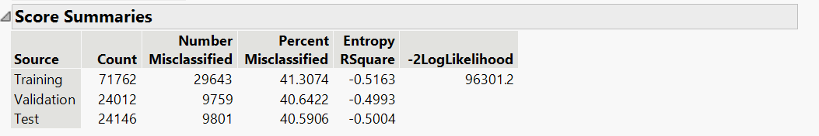
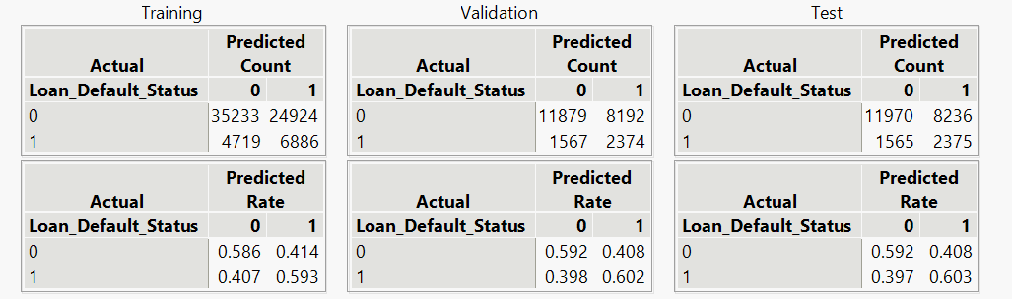
7. Appendix
J. Discriminant Analysis:

Slide 32
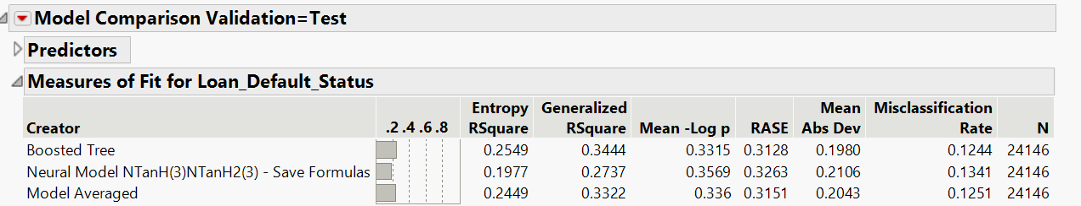
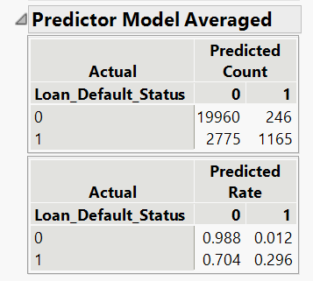
7. Appendix
K. Ensemble Model 2 (Boosted Tree + Neural Networks (2 hidden layers - 3 TanH Nodes per layer))

